Slide 1

Lesson 5-2
Equivalence with
Context-Free Languages
Theory of Computation
王轩
Wang Xuan

Slide 2

Theorem
Context-Free
Languages
(Grammars)
Languages
Accepted by
PDAs

Slide 3
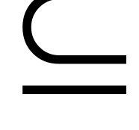



Proof - Step 1
Context-Free
Languages
(Grammars)
Languages
Accepted by
PDAs
Convert any context-free grammar
to a PDA with:

Slide 4


First Step
Take an arbitrary context-free grammar
We will convert to a PDA such that:
In another word, the main idea is to design a
automaton so that it simulates the grammar.

Slide 5
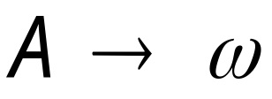

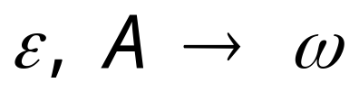






Conversion Procedure
For each
For each
production in
terminal in
Add transitions

Slide 6
Place the marker symbol $ and the start variable on the stack.
Repeat the following steps forever.
  If the top of stack is a variable symbol A, nondeterministically select one of the rule for A and substitute A by the string on the right-hand side of the rule.
  If the top of stack is a terminal symbol a, read the next symbol from the input and compare it to a. If they match, repeat. If they do not match, reject on this branch of the nondeterminism.
  If the top of stack is the symbol $, enter the accept state. Doing so accepts the input if it has all been read.

Slide 7

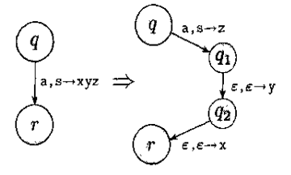
The procedure popping s and pushing xyz, when reading a can be converted as popping s and pushing z, when reading a. Then pushing y and x in turn.

Slide 8
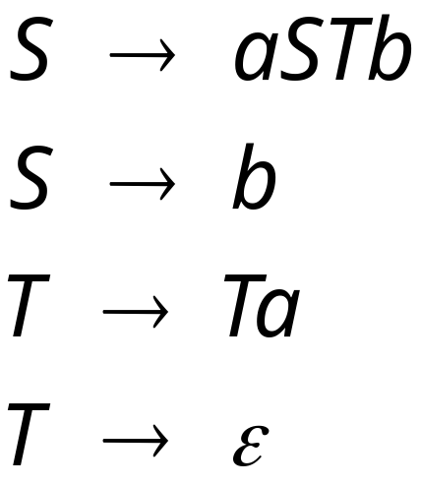
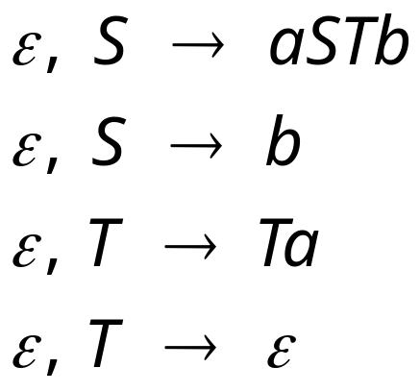
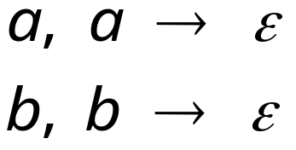
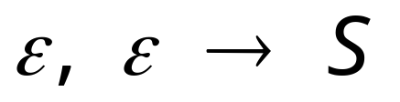
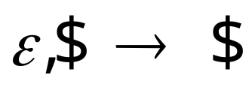
Example
Grammar
PDA

Slide 9




Example:
Input
Time 0
Stack

Slide 10


Derivation:
Input
Time 1
Stack

Slide 11


Derivation:
Input
Time 2
Stack

Slide 12
Derivation:
Input
Time 3
Stack

Slide 13

Derivation:
Input
Time 4
Stack

Slide 14
Derivation:
Input
Time 5
Stack

Slide 15
Derivation:
Input
Time 6
Stack

Slide 16
Derivation:
Input
Time 7
Stack

Slide 17
Derivation:
Input
Time 8
Stack

Slide 18
Derivation:
Input
Time 9
Stack

Slide 19
Derivation:
Input
Time 10
Stack
accept

Slide 20
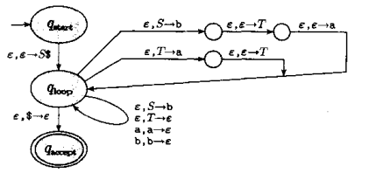
Example
S→aTb|b
T→Ta| ε

Slide 21
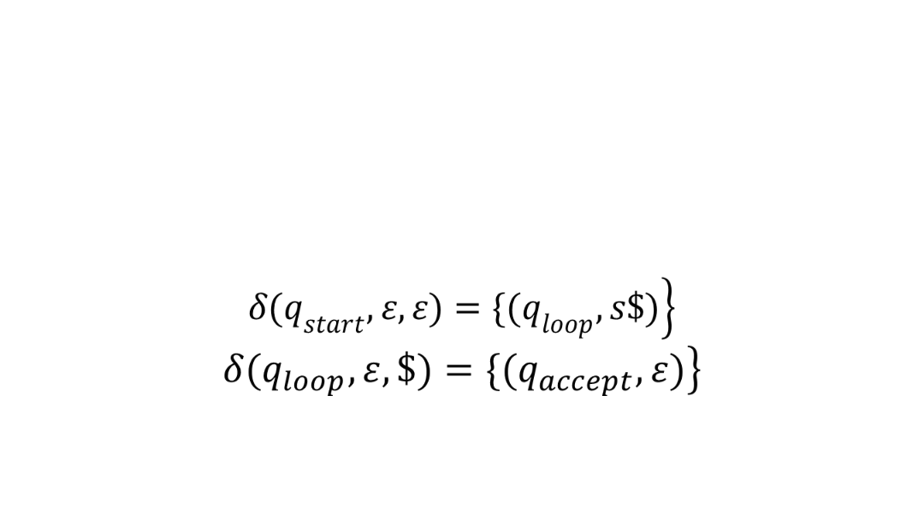
S→aTb|b
T→Ta| ε

Slide 22
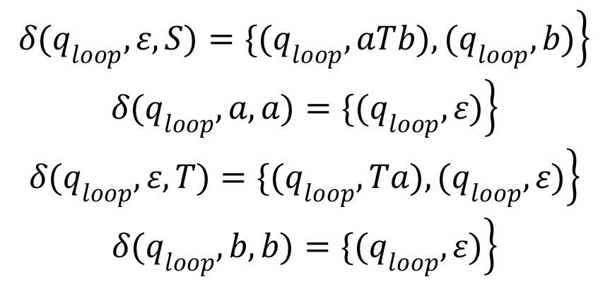
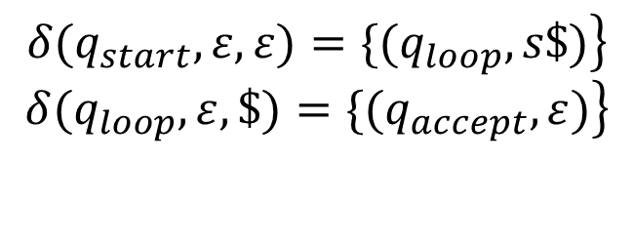
S→aTb|b
T→Ta| ε

Slide 23

Proof - Step 2
Context-Free
Languages
(Grammars)
Languages
Accepted by
PDAs
Convert any PDA to a context-free
grammar with:

Slide 24
Second Step
We have a PDA P, and we want to make a CFG G that generates all the strings that P accepts
We will convert a PDA M to CFG G such that:
L(M) = L(G)

Slide 25
Conversion Procedure
First, we simplify our task by modifying P slightly to give it the following three features.
  1. It has a single accept, q_{accept}.
  2. It empties its stack before accepting.
  3. Each transition either pushes a symbol onto the stack (a push move) or pops one off the stack(a pop move), but it does not do both at the same time.

Slide 26
Two cases of computation
For any input string x, P’s first move on x must be a push, the last move on x must be a pop. Two cases occur during P’s computation.
  1. The stack is empty only at the beginning and the end of P’s computation on x.
  2. The stack becomes empty at some point.

Slide 27
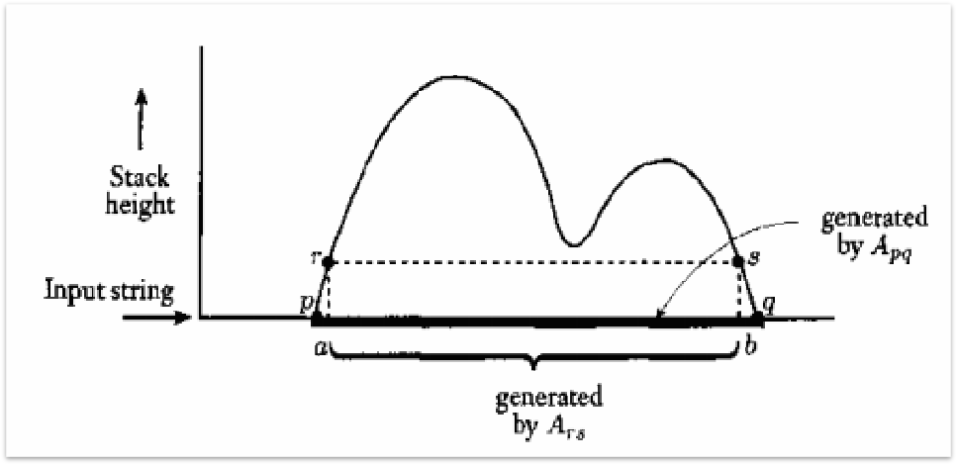
The stack is empty only at the beginning and the end of P’s computation on x.
A_{pq}→aA_{rs}b

Slide 28
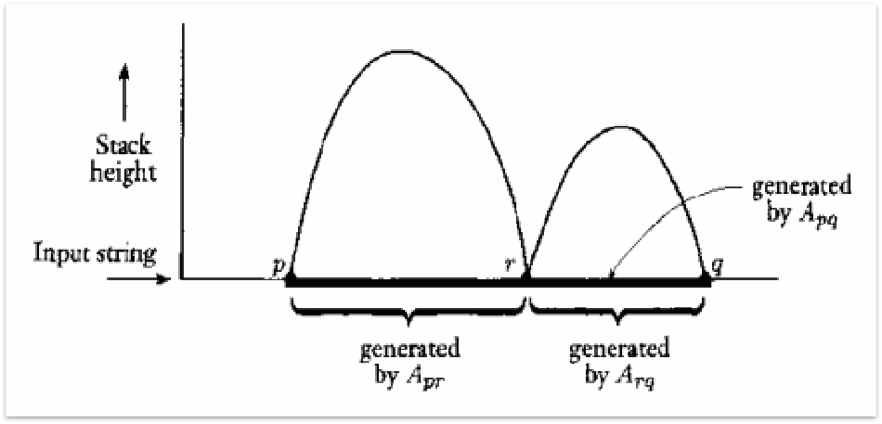
  The stack becomes empty at some point.
A_{pq}→A_{pr}A_{rq}

Slide 29
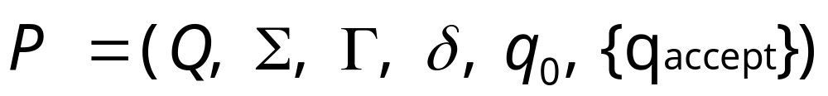

Conversion Procedure
Construct G=(V,T,S,P)
The variables V of G are {A_{pq}|p,q∈Q} .
The terminal symbols T
The start variable S is A_{qo, qaccept}.
The set of productions P are defined as below:
  1. For each p, q, r, s ∈Q, t∈ ，and a, b∈Σ_{ε}, if δ(p, a, ε) contains (r, t) and δ(s, b, t) contains (q, ε) , put the rule A_{pq}→aA_{rs}b in P.
  2. For each p, q, r ∈Q, put the rule A_{pq}→A_{pr}A_{rq} in P.
  3. For each p∈Q, put the rule A_{pp}→ ε in P.

Slide 30
Now we prove that this construction works by demonstrating that A_{pq} generates x if and only if x can bring PDA P from p with empty stack to q with empty stack.
Consider each direction of the proof.
  1. A generates x ⇒ x can bring P from p to q with empty stack.
  2. x can bring P from p to q with empty stack⇒ A generates x.

Slide 31

Proof 1
Proof: If A_{pq} generates x, then x can bring P from p with empty stack to q with empty stack.
  Basis： A_{pp}→ ε
  Assume true for derivations of length at most k, where k≥1.
  Suppose A_{pq} x with k+1 steps. The first step is A_{pq}→aA_{rs}b
  or A_{pq}→A_{pr}A_{rq}.
  1. A_{pq}→aA_{rs}b: A_{rs} y in k steps, x=ayb.
  2. A_{pq}→A_{pr}A_{rq}: A_{pr} y, and A_{rq} z, x = yz.

Slide 32
Proof 2
Proof: If x can bring P from p with empty stack to q with empty stack, then A_{pq} generates x.
  Basis: the computation has 0 steps, x = ε, and the rule A_{pp}→ ε in G.
  Assume true for computations of length at most k, where k≥0.
  Suppose that P has a computation wherein x brings p to q with empty stacks in k+1 steps.

Slide 33
Proof 2
  1. The stack is empty only at the beginning and end.
    Let x = ayb, y can bring PDA P from r to s without touching the symbol t that is on the stack. Removed the first step and the last step of the k+1 steps, the computation of y has k-1 steps. Thus A_{rs}→ y, hence A_{pq} x
  2. The stack becomes empty elsewhere, too.
    Let r be the state where the stack becomes empty, so the computation from p to r and from r to q each contain at most k steps. Let y be the input from p to r, z be the input from r to q. A_{pr}→ y , A_{rq}→ z and x = yz. Because the rule A_{pq}→ A_{pr}A_{rq} is in G, A_{pq}→ x.
End prove

